Slide 1
Spring Boot Essentials: A Practical Introduction
Presented By: Mirazul Islam Java Instructor, EU

Slide 2
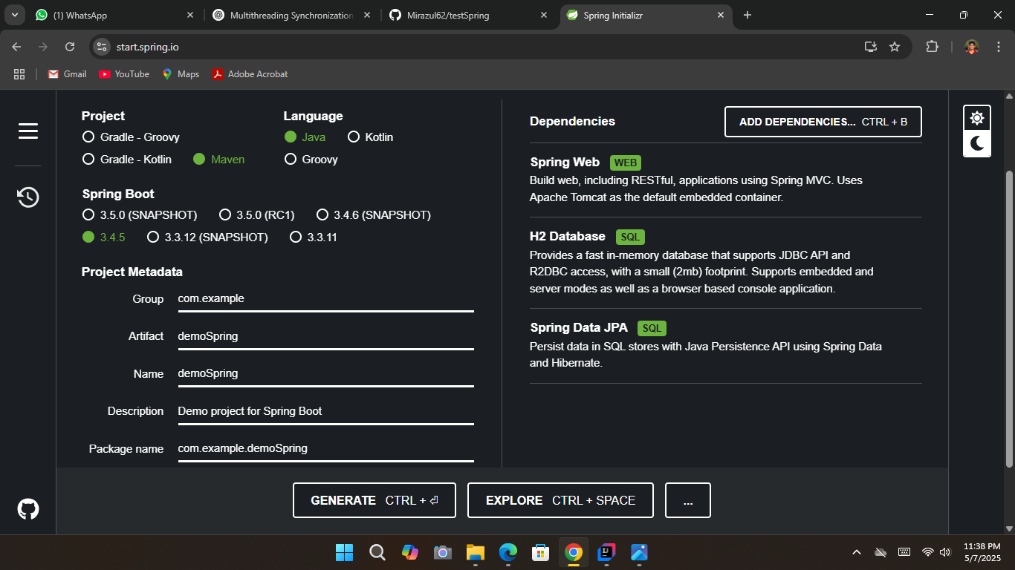
What is Spring Initializr?
A web-based project generator for Spring Boot
Helps you quickly set up a new Spring Boot application
Provides customizable project configuration and dependencies

Slide 3
H2 Database Overview
In-memory mode: Data is stored in RAM (disappears after app stops)
Embedded or Server modes
SQL-compliant
Zero installation (jar-based)
Simple web-based console (h2-console)
Easy integration with Spring Boot

Slide 4
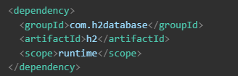
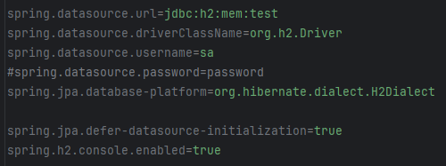
Spring Boot + H2 Setup
Add dependency in pom.xml:
Configure in application.properties:
Access H2 Console:
URL: http://localhost:8080/h2-console

Slide 5
What is pom.xml?
pom.xml stands for Project Object Model and is the core configuration file used in Maven projects.
It's an XML file that tells Maven:
What the project is (name, version, description)
What dependencies it needs
How to build and package the project
What plugins and goals to use
Project structure and other metadata

Slide 6
What is JPA?
JPA (Java Persistence API) is a Java specification for managing relational data in Java applications. It defines how Java objects are mapped to database tables and how to manage their lifecycle (create, read, update, delete).
ORM (Object-Relational Mapping): Maps Java classes to database tables.
Annotations: Uses annotations like @Entity, @Table, @Id, @Column to define mappings.
Entity Manager: Provides API to interact with the database.
JPQL (Java Persistence Query Language): Object-oriented version of SQL.

Slide 7
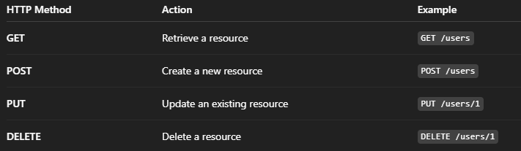
Introduction to REST(Representational State Transfer)
Architectural style for designing networked applications
Uses standard HTTP methods for CRUD operations
Stateless and scalable communication
HTTP Methods in REST

Slide 8
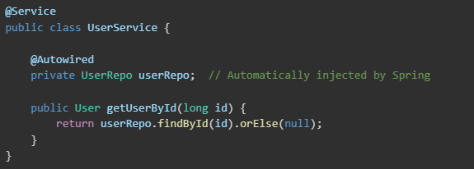
@Autowired in Spring
@Autowired is a Spring annotation used for dependency injection. It allows Spring to automatically inject the necessary dependencies into a class at runtime, making the class less dependent on external configuration.
In this example, the userRepo dependency is automatically injected into the UserService class by Spring. No explicit instantiation or configuration is required.

Slide 9
What is MVC?
MVC stands for Model-View-Controller
A design pattern that separates application logic into three interconnected components

Slide 10
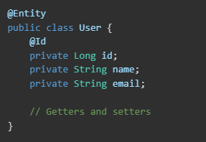
Model in Spring

Slide 11

View
Represents the user interface (UI) elements of the application.
In Spring, views are typically JSP or Thymeleaf templates that present the data from the model.

Slide 12
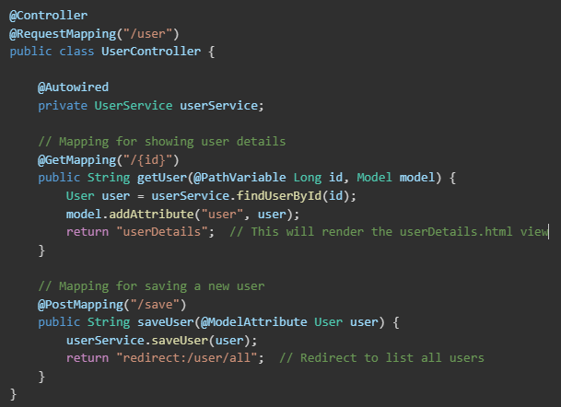
Controller
Acts as an intermediary between the Model and the View.

